Slide 1
WIVR with EXTERNAL CONTROLLER
Group number 15
Andrea Pasquali - andrea1.pasquali@mail.polimi.it
Riccardo Redaelli - riccardo5.redaelli@mail.polimi.it

Slide 2
Technologies
Our system is based on DayDream Device which is composed by a controller and a visor and is compatible with some Android phones. This controller has three degrees of freedom and it is useful to interact with virtual worlds.
HW technologies Daydream visor Daydream controller Compatible smartphone Monitor for streaming | SW technologies Chrome beta 56 installed on the smartphone

Slide 3
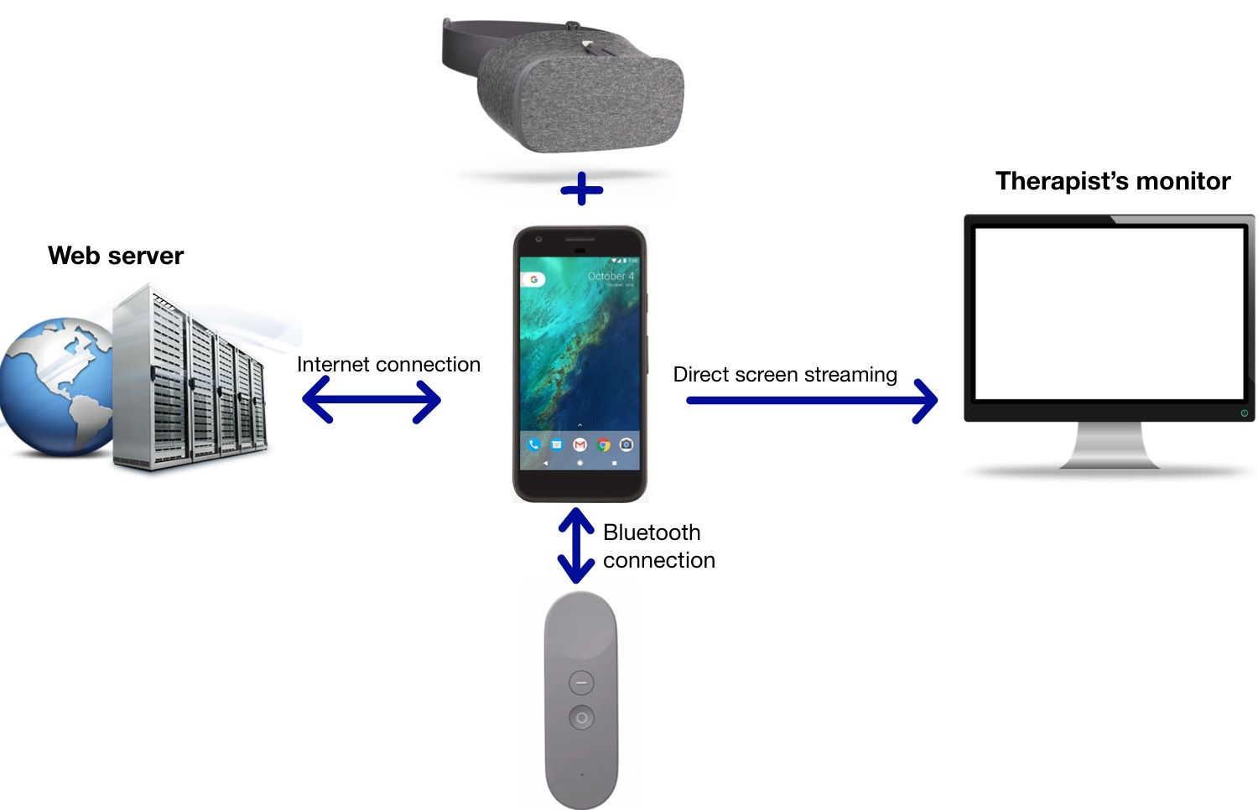
Architecture of our system
Client-Server
Thin client that accesses throught browser to the server where the logic of the application is contained.
Therapist can display what the patient sees through the streaming of the mobile device on his monitor.

Slide 4
Scenario
We built our application in order to help people with NDD to increment coordination between hands and eyes. To do that we developed a game based on DayDream technology. With our application, a patient that has problems in doing simple actions (like taking a glass of water or drawing with a pen) will improve his level of coordination and concentration enjoying himself. From the therapist’s side, it will be easier to convince his patients to concentrate on an exercise, showing it as a game.

Slide 5
Concept
The patient is shown a virtual world in which he has to point an object that he can move clicking on the controller button and keeping the pressure, he can drag it around him. The goal is to reach an established point, following a path without getting out of it. He also has the possibility to release the button on the path, creating a ‘checkpoint’, from which he can resume the game.
We will also implement the possibility for the therapist to choose the difficulty of the path depending on the patient. Moreover it will be possible to visualize some statistics of the performance (like time spent to finish it or how many breaks the patient did during the game).

Slide 6
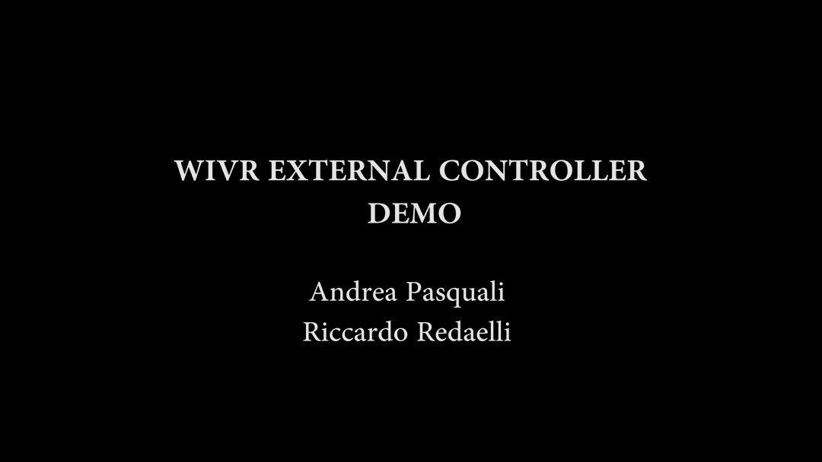
Demo
VIDEO

Slide 7
The End
Thank you for your attention

